Slide 1
Java Basics-Assignment
Name :M. Santhosh Kumar Batch:Non IT to IT April Batch -2023 Date:23/04/2023

Slide 2
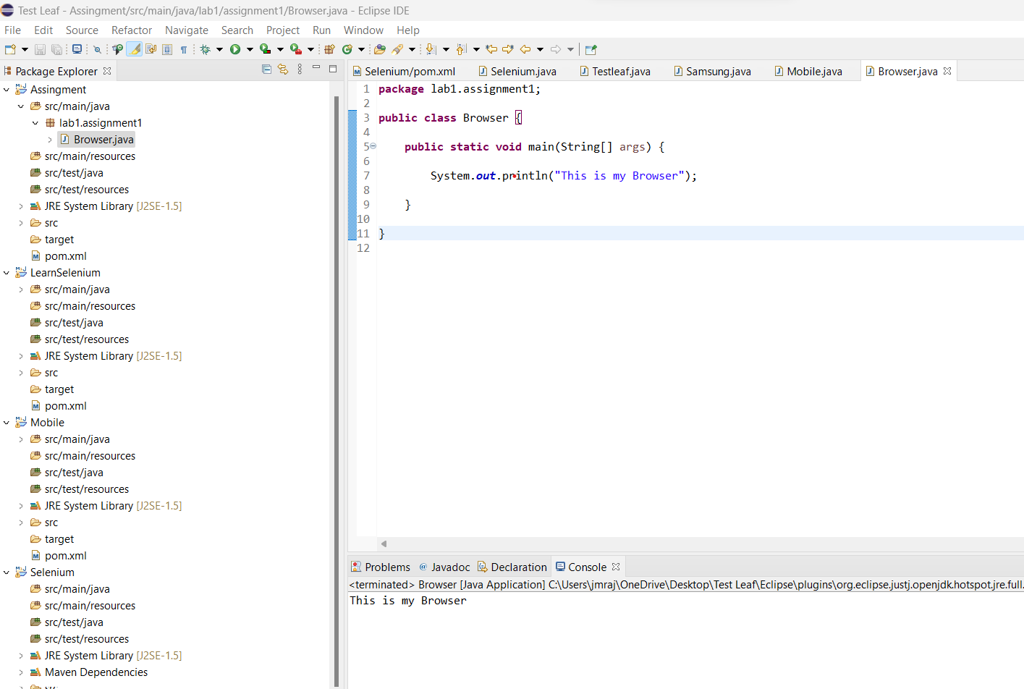
Assigment-1(To Understand the Class, Main method and Sysout)

Slide 3
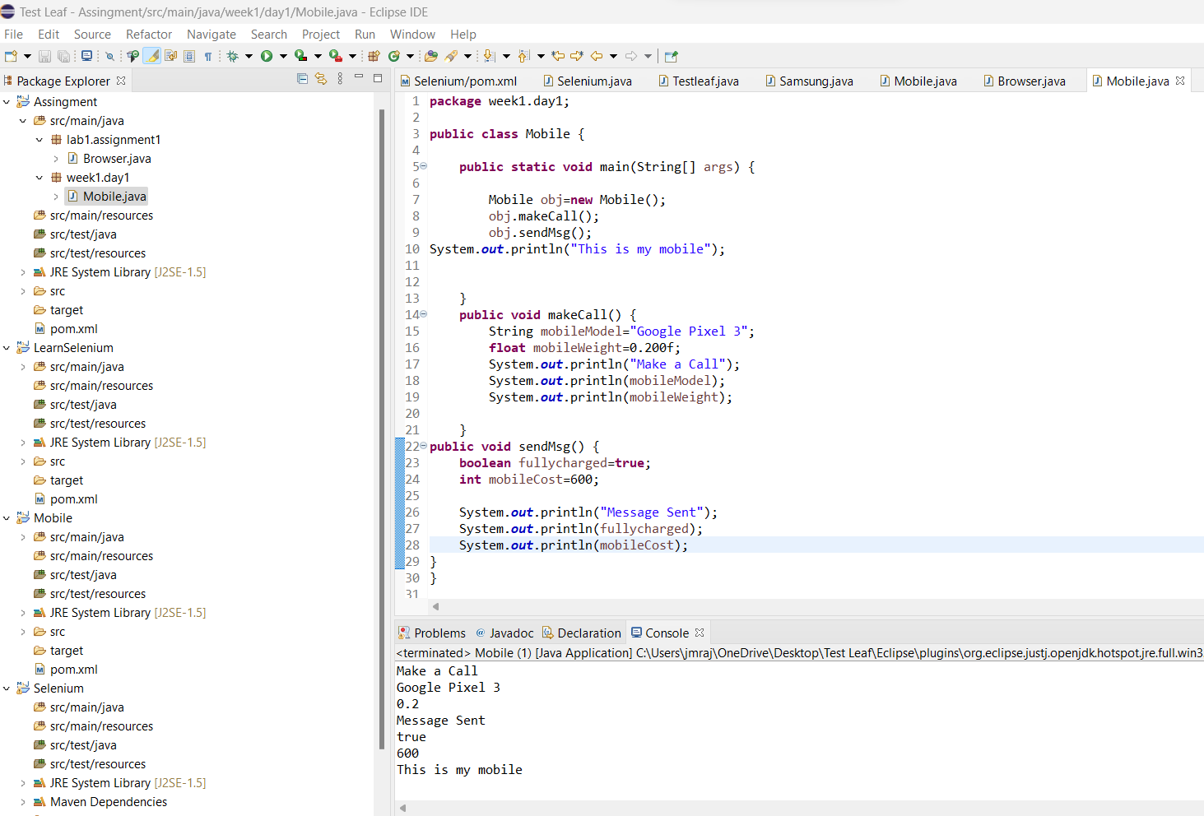
Assignment -2 Create object for class and call from main method .

Slide 4
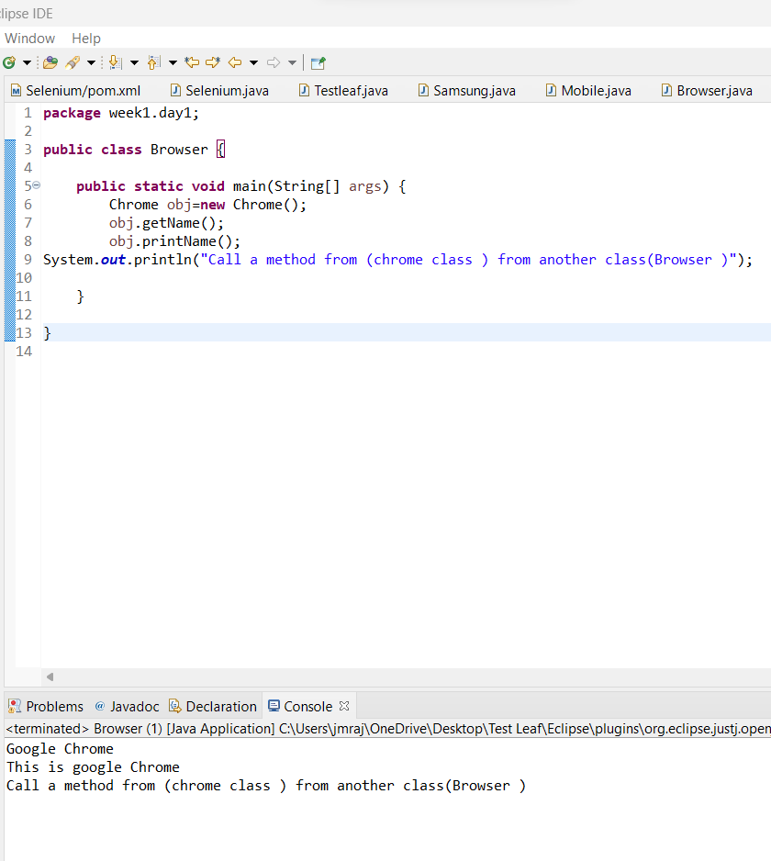
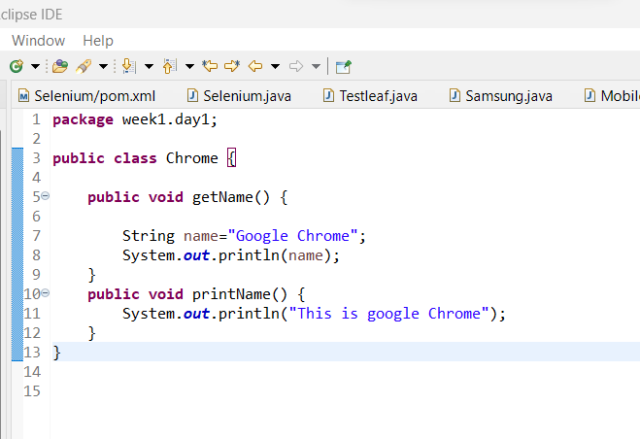
Assignment 3:Call a method from another class

Slide 5
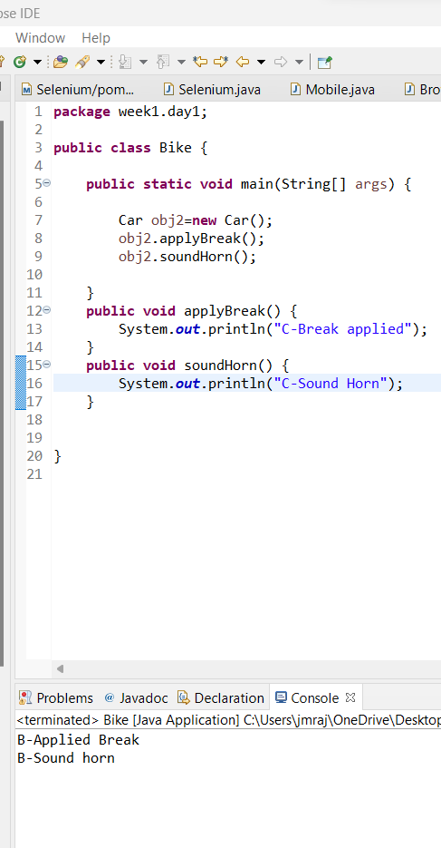
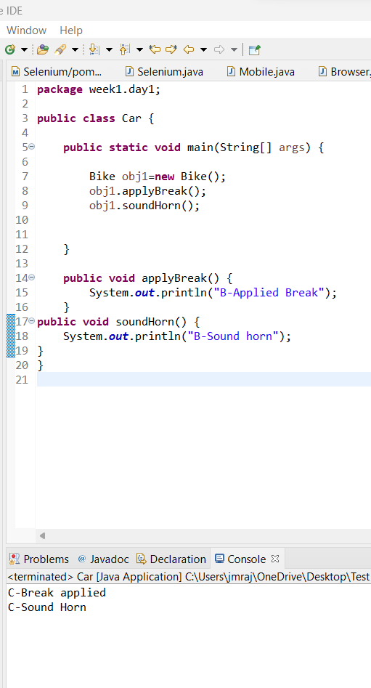
Assignment 4:Create two objects for two classes

Slide 6
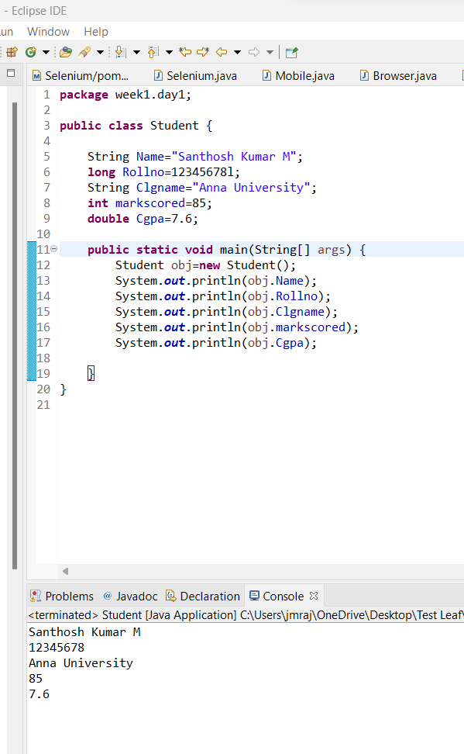
Assignment -5 Create Object for Student Class in main method and print all the variables

